Slide 1
HARDWARE 3D SHADERS
DEV4 day3

Slide 2
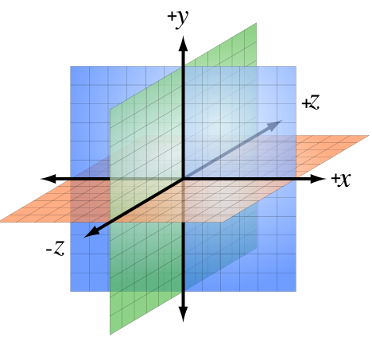
3D Coordinate SYSTEMS
You can pretty much choose what axis means what (labels) and even choose the axis polarity. (+/-)
What matters is your 3D coordinates be converted to the API’s final NDC representation.
This conversion is one of the roles of the projection matrix. (and is why they differ per API)
The most common coordinate systems are left-handed and right-handed systems. (right-handed has Z flipped)
Left-Handed Coordinate System

Slide 3
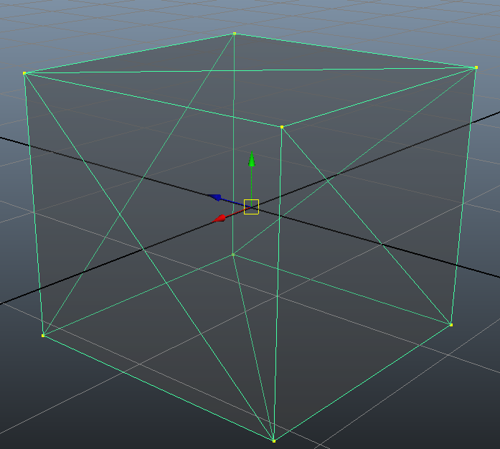
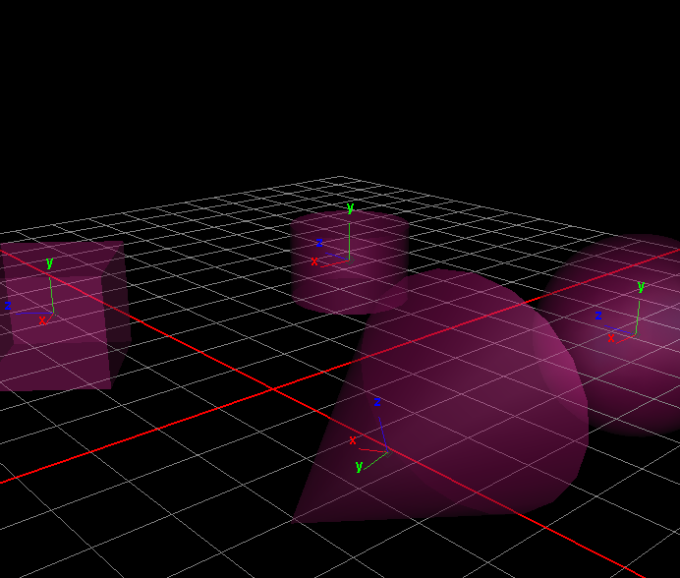
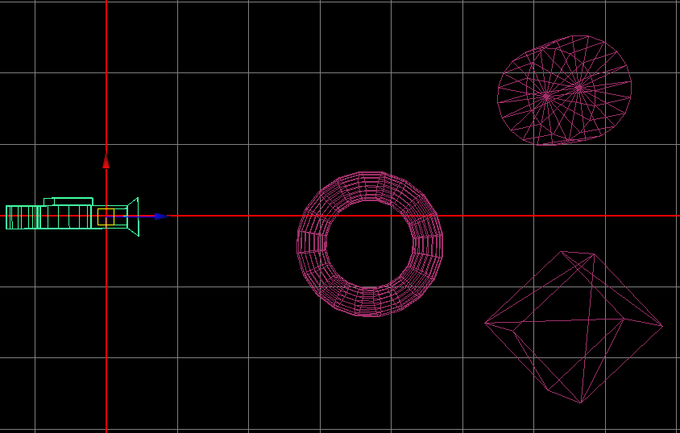
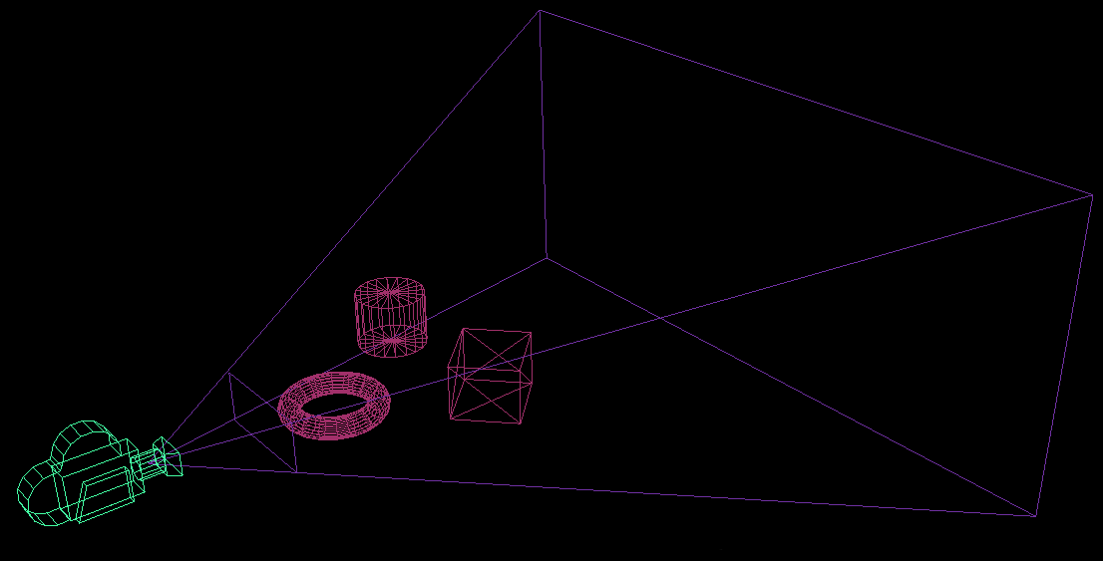
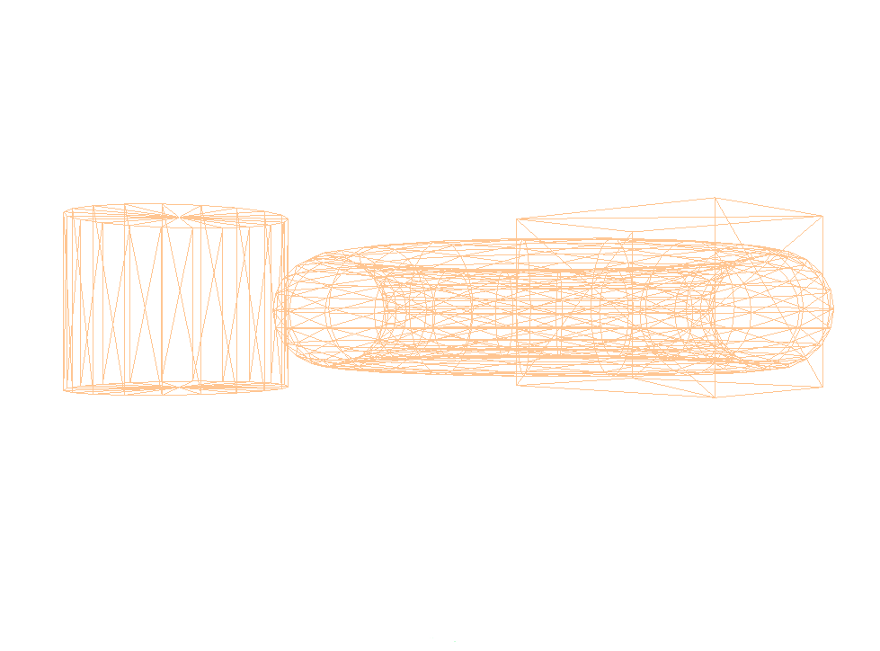
SPATIAL VERTEX TRANSFORMS
BUFFER
WORLD/GLOBAL SPACE
INVERSE CAMERA SPACE
A.K.A VIEW SPACE
SHADER
LOCAL/OBJECT SPACE
SHADER
RASTERIZER
XYZ/W
VIEW SPACE PROJECTED (NEAR CLIP SPACE)
NORMALIZED DEVICE
COORDINATE SPACE
SHADER

Slide 4
Local/OBJECT Space
The original space in which your vertex data is defined.
The origin represents the point where your vertex data is translated, rotated and scaled about.
A pivot/delta matrix is often used to adjust the point of a meshes local transformations.
BUFFER

Slide 5
World/GLOBAL Space
The space where the all the 3D models, lights and other objects are defined and manipulated.
This represents the space we as humans tend to define things in when describing our surroundings.
Even away from the origin, each object maintains a local space. The pivot axis in this image represent that space.
Matrix multiplication order impacts which space an object will move through. (local or global)
SHADER

Slide 6
INVERSE CAMERA SPACE (VIEW SPACE)
Defines how world space objects are relative to a camera/viewing matrix.
A camera is just another world space object (a 4x4 matrix) that has no geometry data associated with it.
The XYZ position is the Eye and the 3x3 orientation is the Angle from which we view world space.
We can manipulate it like any other object, but we must invert a copy of it right before sending it to our shaders.
This means when vertices are multiplied by it, they are placed relative to the matrix origin.
SHADER

Slide 7
Projection/CLIP Space
There are two common types of projection matrix: perspective and orthographic.
Both types account for the aspect ratio, adjust Z depths to fall between NDC near/far (for Z buffering) and convert to an API’s NDC axis if required.
A perspective projection will also inject Z into W so that vertices farther away are scaled during the perspective divide. (Performed by the Rasterizer)
SHADER

Slide 8
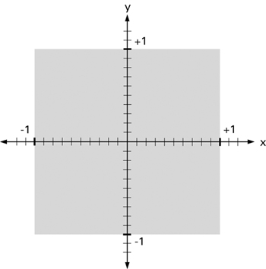
NORMALIZED DEVICE COORDINATE SPACE
RASTERIZER
XYZ/W
Projection Space is also where the graphics hardware clips lines and triangles to the near-plane. (Rasterizer Input Space)
After near-plane clipping is performed, the perspective divide is applied to each clipped vertex. (XYZ/W)
Now the 3D primitives can be interpreted as 2D shapes. Drawing is performed and interpolated attributes are sent to the Pixel Shader.

Slide 9
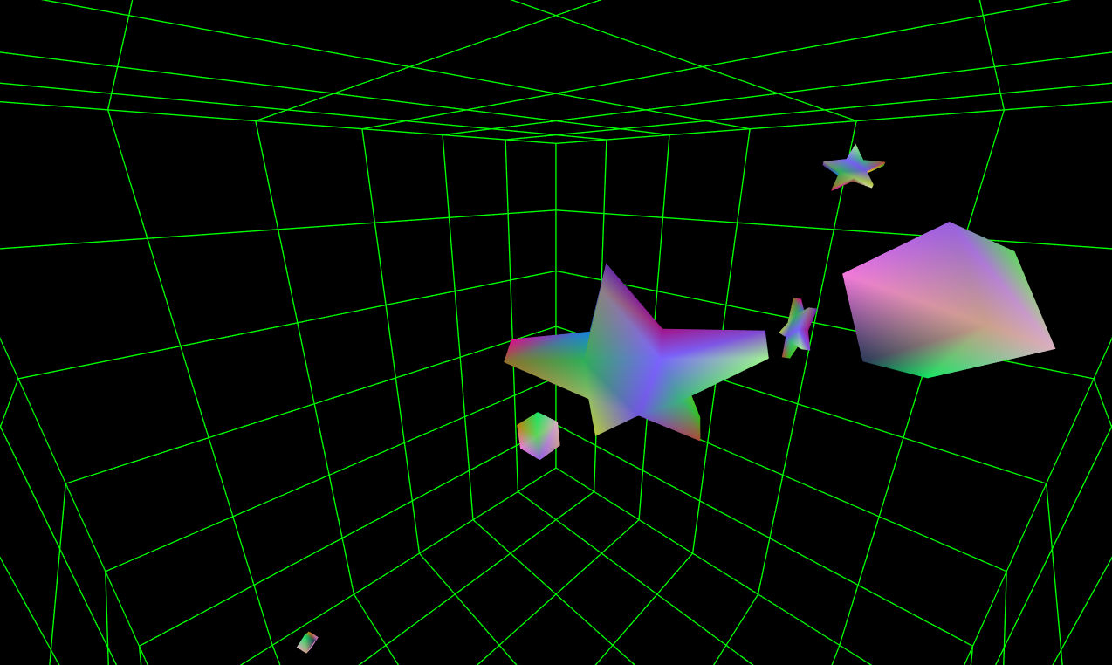
MULTIPLE 3D MESHES/OBJECTS

Slide 10
DRAWING MULTIPLE 3D MESHES: REQUIRMENTS
Each mesh needs a matrix that represents where it is in the world.
If a mesh is part of a hierarchy, it should be be multiplied down the tree until you hit world space.
Each scene will need a view and projection matrix.
View is the inverse camera, and projection is based on FOV, AR, Near/Far. A scene might also contain a list of what to draw.

Slide 11
DRAWING MULTIPLE 3D MESHES: EXECUTION
Pre-Combine your matrices (optional) and author a vertex shader that uses them to move the vertex data to projection space.
Upload your matrix data each frame as shader uniforms.
Instruct each draw call on which matrices to use.
Multiple ways to achieve this: Direct Overwrite, Uniform Index, Vertex ID, etc.…

Slide 12

DEMO: LETS USE RENDERDOC

Slide 13
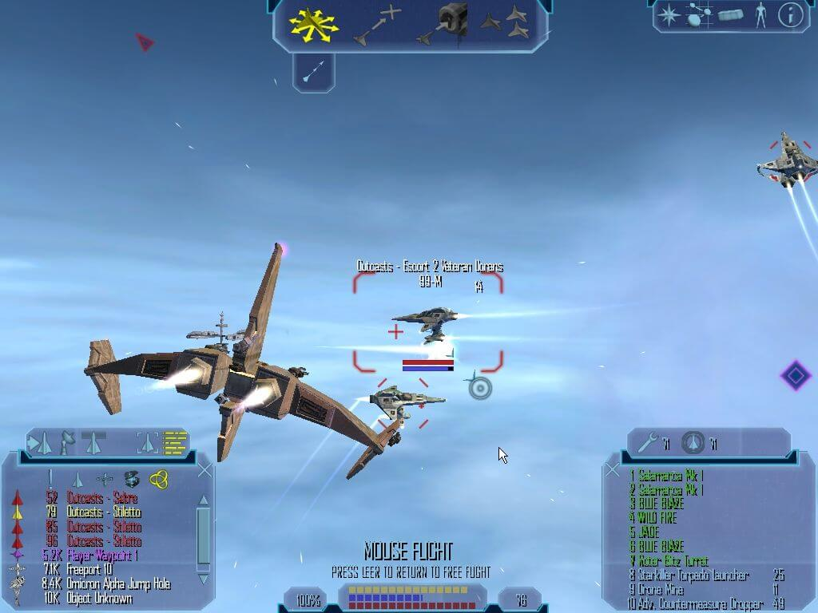
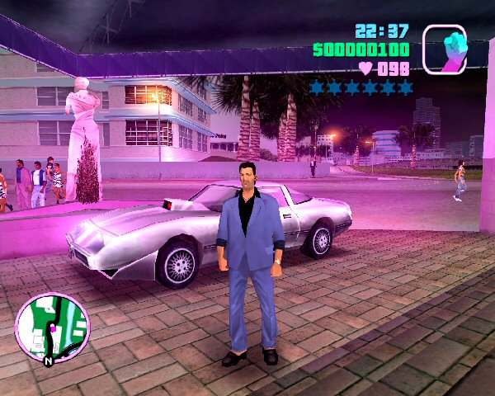
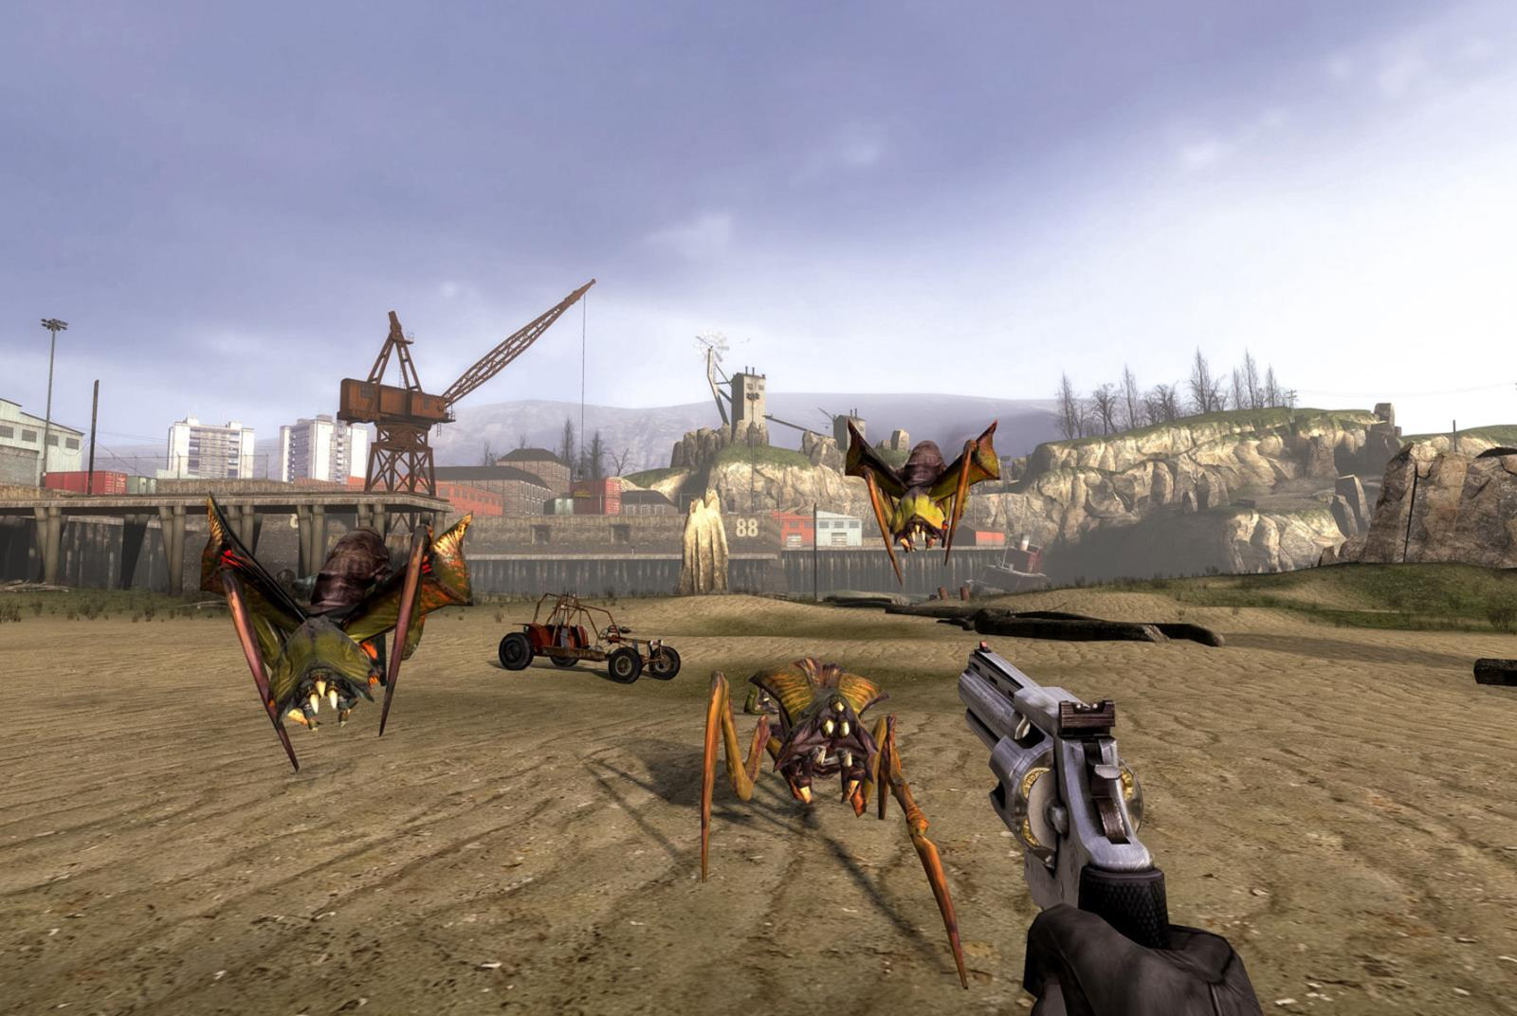
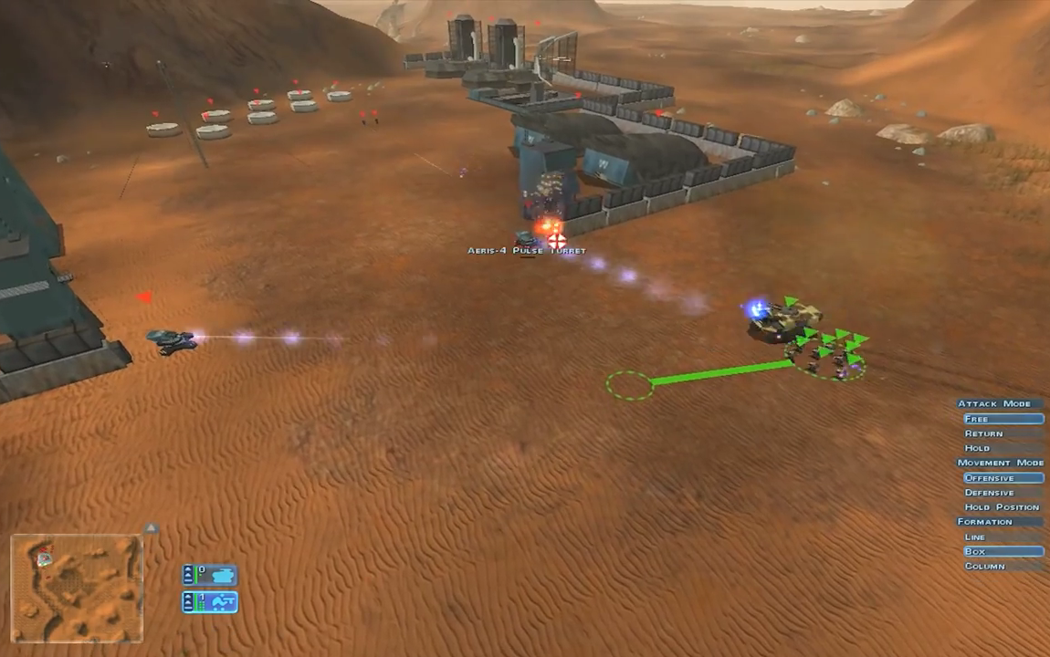
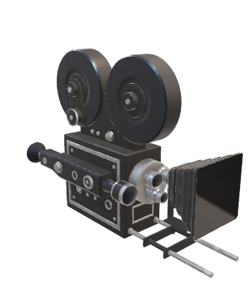
3D Cameras & behaviors

Slide 14
CAMERA CONTROLS & BEHAVIORS: First person
First Person Shooters offset the camera vertically from the player’s collision volume.
Translation is handled locally with the Y clamped to the ground with some bobbing. (Tip: try sin/cos for the bobbing)
Rotation is combination of Local Pitch and Global Yaw.

Slide 15
CAMERA CONTROLS & BEHAVIORS: THIRD person
Third person and driving games will record a buffer of player matrices.
They then interpolate between them each frame. The camera is offset based on the result to create a smooth follow camera.
The camera matrix will have a collision volume to prevent it from intersecting with the level geometry.
These cameras typically will have Pitch and Yaw but no Roll.

Slide 16
CAMERA CONTROLS & BEHAVIORS: FLYING/SPACE
Space and Flying games also use interpolated follow cameras.
However, these allow for Roll and try to keep the camera pointed toward the path of flight/targeting instead of just the vehicle itself.
Addionally these and third person cameras typically allow the user some direct control over orbiting the camera globally around the user’s avatar.

Slide 17
CAMERA CONTROLS & BEHAVIORS: STRATEGY
Strategy and classic PC role-playing games often use a fixed vertical/top-down camera.
The Y position adjusts based on the height of the current terrain.
FOV Zoom is optional and generally depends on a design choice.
Global Yaw is often supported but Pitch and Roll are very limited or disabled.
Meshes blocking the camera will often have transparency forced on.

Slide 18
Q

Slide 19
Placeholder: PIVOT MATRIX EXAMPLE

Slide 20
PLACEHOLDER: MATRIX HEIRARCHY EXAMPLE

